Slide 1
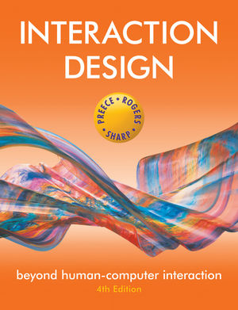
Chapter 9
THE PROCESS OF INTERACTION DESIGN

Slide 2
Overview
What is involved in Interaction Design?
Importance of involving users
Degrees of user involvement
What is a user-centered approach?
Four basic activities
Some practical issues
Who are the users?
What are ‘needs’?
Where do alternatives come from?
How to choose among alternatives?
How to integrate interaction design activities in other lifecycle models?

Slide 3
What is involved in Interaction Design?
It is a process:
a goal-directed problem solving activity informed by intended use, target domain, materials, cost, and feasibility
a creative activity
a decision-making activity to balance trade-offs
Generating alternatives and choosing between them is key
Four approaches: user-centered design, activity-centered design, systems design, and genius design

Slide 4
Importance of involving users
Expectation management
Realistic expectations
No surprises, no disappointments
Timely training
Communication, but no hype
Ownership
Make the users active stakeholders
More likely to forgive or accept problems
Can make a big difference to acceptance and success of product
Notes:
Preamble:
Often common to involve proxy users, but they will not have the same perspectives as users who perform the task every day, or on a regular basis.
It is important that developers continue to take users activities into account when creating a system.
Slide:
Two other important parts to make products usable and used is expectation management and ownership:
Expectation:
- users should not feel cheated when they get the product. The prduct should not over promise to the user, then this will cause resistance and rejection. Marketing should be careful not to mis represent the product.
Involving users from an early stage of development is good, as they will see that the product’s capabilities are.
If users have a change to train with the product through development releases or pre-release versions, hands-on demonstrations and videos, then they will understand better what to expect when the final product arrives.
Ownership:
- Users who are involved and feel that they have contributed to a product’s development are more likely to feel a sense of ownership towards it and support it.

Slide 5
Degrees of user involvement
Member of the design team
Full time: constant input, but lose touch with other users
Part time: patchy input, and very stressful
Short term: inconsistent across project life
Long term: consistent, but lose touch with other users
Newsletters and other dissemination devices
Reach wider selection of users
Need communication both ways
User involvement after product is released
Combination of these approaches
Notes:
Users can also influence the development through engagement of the development team with potential users through product workshops.
Newsletter, blogs, and user input and feedback on updated blogs may be helpful in setting expectations and providing users with a way to get involved with a products development.
Costs associated with involving users:
- One study found that some low level of user involvement was beneficial where as too much can lead to problems. High user involvements can generate conflicts and cost associated with increased reworking.
Involving different users in different stages of the product development may be beneficial.
If there is no clear conceptual model, then user opinions can vary vastly.

Slide 6
What is a user-centered approach?
User-centered approach is based on:
Early focus on users and tasks: directly studying cognitive, behavioral, anthropomorphic & attitudinal characteristics
Empirical measurement: Early in development, users’ reactions and performance to scenarios, manuals, simulations & prototypes are observed, recorded and analysed. Later on, users interact with simulations and prototypes and their performance and reactions are observed, recorded and analyzed.
Iterative design: when problems are found in user testing, fix them and carry out more tests
Notes:
Early focus: This requires observing users doing their normal tasks, studying the nature of those tasks, and then involving users in the design process.
Empirical measurement:
Iterative design: This means that design and development is iterative, with cycles of design-test-measure-redesign being repeated as often as possible.

Slide 7
Four basic activities in Interaction Design
Establishing requirements
Designing alternatives
Prototyping
Evaluating

Slide 8
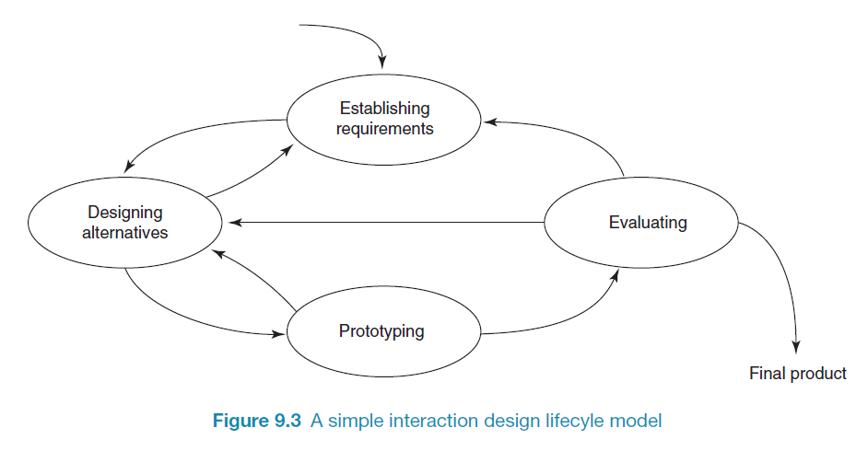
A simple interaction design lifecycle model
Exemplifies a user-centered design approach
Notes:
This interaction design lifecycle model augments other models of software engineering such as the Waterfall, Spiral, RAD models, with a user centric approach to interaction design. It is not meant to be prescriptive, but as a general guideline to interaction design approach.
1. Establishing requirements: In order to design something to support people, we must know who our target users are and what kinds of support and interactive product could usefully provide.
Understanding these needs is gleaned through data gathering and analysis, which are discussed in chapters 7.
2. Designing Alternatives: Conceptual design involves producing the conceptual model for the product, and the conceptual model describes an abstraction outlining what people can do with a product and what concepts are needed to understand how to interact with it. Concrete design includes, color, sound, menu design, and icons to use, and based on these concrete design a few alternative conceptual models are put forth.
3. Pototyping: The most sensible way for users to evaluate such design is to interact with them, and this can be achieved through prototyping.
Not necessarily involving software, paper-based design protytypes are very quick and cheap to build and are very effective for identifying problems in the early stages of design, and through role-playing users can get a real sense of what it would be like to interact with this product.
4. Evaluating: This is the process of determining the usability and acceptability of the product or design that is measured in terms of usability and user experience criteria.
Interact design requires a high level of user involvement throughout development, and this enhances the chances of an acceptable product being delivered.
Evaluating the design or prototypes can be fed back into further design or might allow for the identification of missing requirements. This iteration is one of the key characteristic of a user-centered approach.

Slide 9
Some practical issues
Who are the users?
What do we mean by ‘needs’?
How to generate alternatives
How to choose among alternatives
How to integrate interaction design activities with other lifecycle models?

Slide 10
Who are the users/stakeholders?
Not as obvious as you think:
those who interact directly with the product
those who manage direct users
those who receive output from the product
those who make the purchasing decision
those who use competitor’s products
Three categories of user (Eason, 1987):
primary: frequent hands-on
secondary: occasional or via someone else
tertiary: affected by its introduction, or will influence its purchase
Notes:
Most obvious definition is those who interact directly with the product to accomplish a task, however there are other operational definitions.

Slide 11
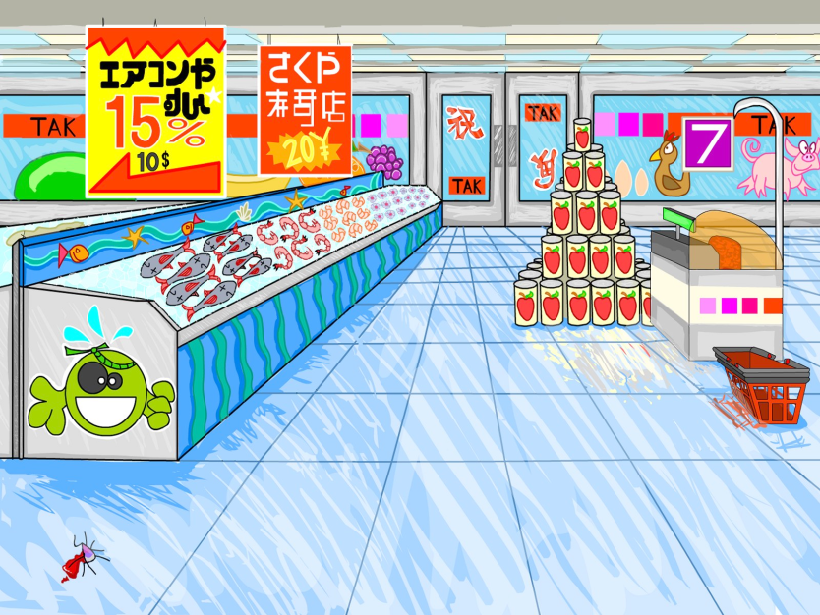
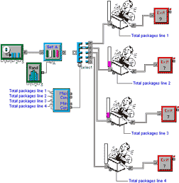

Who are the stakeholders?
Check-out operators
• Suppliers
• Local shop owners
Customers
Managers and owners
Notes:
If you apply these operational definition to conduct a stakeholder analysis. The question here is who are the stakeholders for an automated check-out system of a large supermarket?
First the customer! Their stake in the success and usability of the system is fairly clear and direct. WANT: Customers want the system to work properly so that they are charged the right amount for the goods, receive the correct receipt, and can purchase their goods quickly and efficiently without any frustration.
Second Checkout assistant. People who are available to help customers if they have any problems. Checkout assistants want the customers to be satisfied and happy so that they don’t have to deal with anyone grumpy.
Third, managers and owners: Who also want customers to be happy and satisfied. They also doen’t want to lose money because the system can’t handle payments correctly.
Fourth, supermarket staff: supermarket staff, warehouse staff, suppliers, supermarket owners families, and local shop owners, whose business would be affected by the success and failure of the system. It doesn’t mean that we should consult with suppliers and family to suggest requirements for a supermarket check-out system, but you might want to talk to a warehouse staff, especially if the system links in with stock control and other functions.

Slide 12
What do we mean by ‘needs’?
Users rarely know what is possible
Users can’t tell you what they ‘need’ to help them achieve their goals
Instead, look at existing tasks:
their context
what information do they require?
who collaborates to achieve the task?
why is the task achieved the way it is?
Envisioned tasks:
can be rooted in existing behaviour
can be described as future scenarios
Notes:
If you asked someone on the street in 1998-99 on what they needed, I doubt they would have said interactive “smart” TV, ipad, a ski jacket with integrated mp3 player, smart phone with a gazzilion apps, that are on your finger tips.
However, if you asked the same person if they would buy them if the possibility existed, then they would have a more positive answer. It is NOT SIMPLY ASKING A USER “ WHAT DO YOU NEED?” NO. Because, people don’t necessarily know what is possible. As Robertson and Robertson says (2013) un-dreamed-of needs, which are those that users are unaware of.
Instead, we should approach it by understanding the characteristics and capabilities of users, what they are trying to achieve, how they achieve it currently, and whether they would achieve their goals more effectively and have a more enjoyable experience if they were supported differently by an alternative design.
Personal characteristics can be considered, size of hands denotes the design of buttons and input devices, height denotes the average height of information/checkout kiosk, and strength – toys cannot require too much strength to operate.
It may be tempting for designers simply to design what they would like to use themselves, but their ideas would not coincide with the target user group, because of differing expectations and experiences. Many companies like Netpliance, use a user-centric approach, employ focus groups to study and survey customer’s needs, developers learned from the focus group about the intended users.
Can be grounded in theory as well: Focusing on peole’s goals and on usability and user experience can be a more promising approach than focusing on people’s needs and expectations only to help with the requirements for a product.

Slide 13
How to generate alternatives
Humans stick to what they know works
But considering alternatives is important to ‘break out of the box’
Designers are trained to consider alternatives, software people generally are not
How do you generate alternatives?
‘Flair and creativity’: research and synthesis
Seek inspiration: look at similar products or look at very different products
Notes:
While it is true that some designers have flair and creativity and able to come up with wonderfully inspired designs, very little in the world is really completely new.
For example, steam engines were inspired by the fact that if you have steam kettle on the stove, the steam from the boiling kettle would lift the lid. The kettle provide the inspiration and experience to translate experience gained in one context into a set of principles that could be applied to another.
Innovations usually arise through cross-fertilization of ideas from different perspectives, individuals and contexts; the evolution of product through use or observation; or straight forward copying of other similar product. Creativity is also an incremental process, like in the case of the development of the word processor, early designs were just an electronic typewriter, but the GUI was developed slowly to allow for editing tasks, and inserting pictures, tables and other media in a innovative manner using the WIMP interface.
Alternatives come from seeking different perspective and looking at other designs. The process of inspiration and creativity can be enhanced by promoting a designers own experience and studying other’s ideas and suggestions.
In research, we often go to conference, study the design and experience of other researchers in the field as they design, build, evaluate and study users reactions to various situations. I always encourage students to read papers all the time, the reading of papers sparks creativity in terms of understand how user’s react to different interaction metaphors, what worked and what didn’t, and inspirations for new research opportunities potentially that no one has thought about, or identifying the hole in the literature. Also, giving demos of your current work to people, I tell my students (not often enough) to keep a journal with you, when you giving a demo. You might discover, or your guest might discover something about the system that you never thought about.

Slide 14
How to choose among alternatives
Evaluation with users or with peers, e.g. prototypes
Technical feasibility: some not possible
Quality thresholds: Usability goals lead to usability criteria set early on and check regularly
safety: how safe?
utility: which functions are superfluous?
effectiveness: appropriate support? task coverage, information available
efficiency: performance measurements
learnability: is the time taken to learn a function acceptable to the users?
memorability: can infrequent users remember how to achieve their goal?
Notes:
Will I use a keyboard or a touch screen interface? Will products provide an automatic memory function or not?

Slide 15
How to integrate interaction design in other models
Integrating interaction design activities in lifecycle models from other disciplines needs careful planning
Several software engineering lifecycle models have been considered
Integrating with agile software development is promising
it stresses the importance of iteration
it champions early and regular feedback
it handles emergent requirements
it aims to strike a balance between flexibility and structure
Notes:
Relevant software engineering models that allow for the integration of the Interaction Design Activities inclue eXtreme Programming (XP) Beck and Andres, 2005, Crystal Cockburn 2005), Scrum (Schwaber and Beedle 2002), and Adaptive Software Development (ASD) Highsmith 2000),
The agile software development framework emphasizes the following bullets, that make integration of the IDA easier.

Slide 16
Summary
Four basic activities in the design process
Establishing requirements
Designing alternatives
Prototyping
Evaluating
User-centered design rests on three principles
Early focus on users and tasks
Empirical measurement using quantifiable & measurable usability criteria
Iterative design

